Slide 1
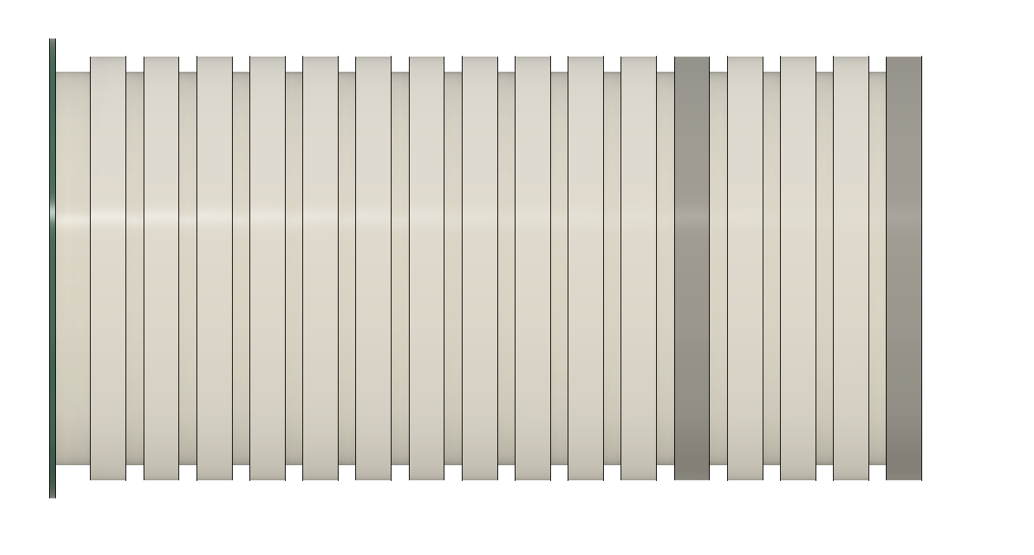
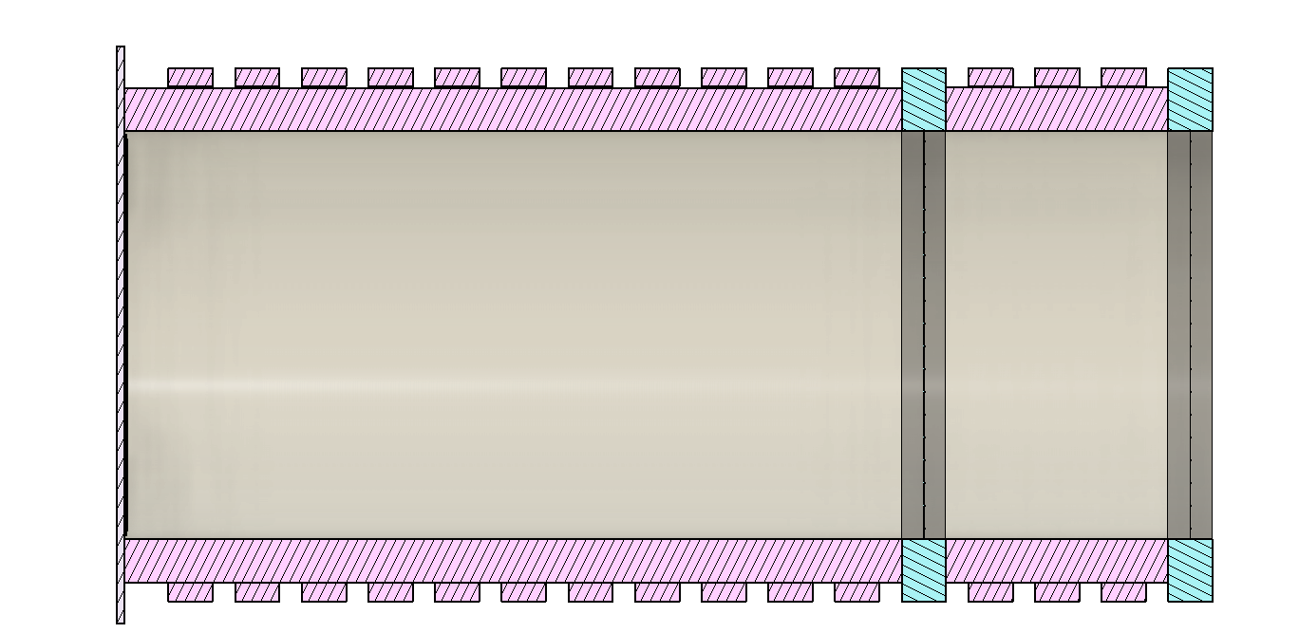
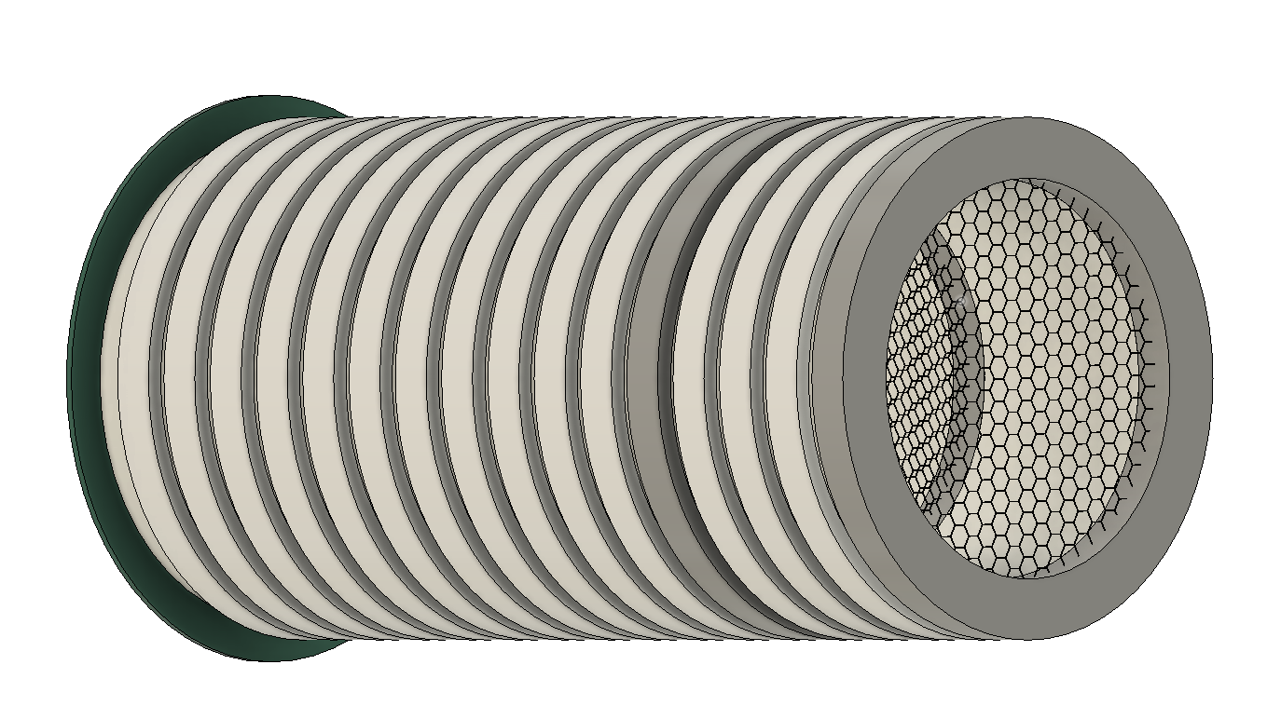
Side View
Side Cross Section Cut
Side Tilt View
A
B
C
D
E
F
A – Collection Plane B – Electron Field Rings C – Electron Drift Region D – High Density Polyethylene
E – Hexagon Mesh Grid Field Rings F – Buffer Region

Slide 2
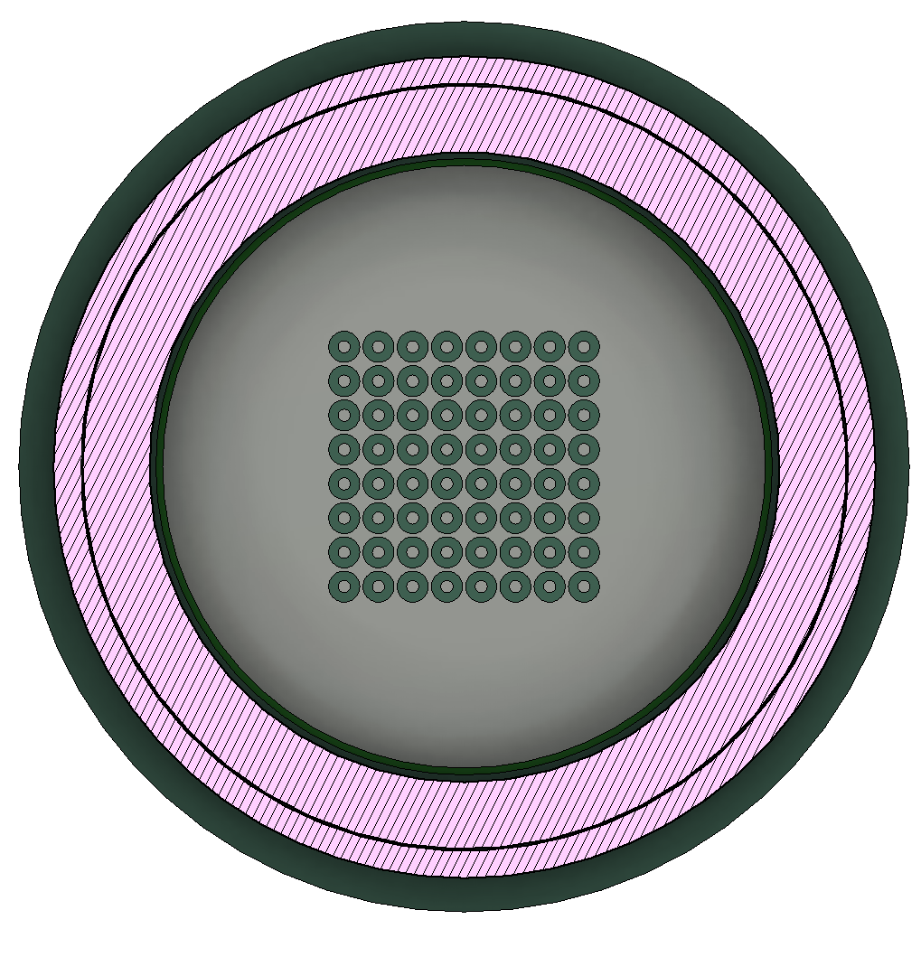
Pixel
Mesh Grid
HDPE
Field Cage Ring

